Slide 1
Pause and Think Online
Notes:
[Play during transition into the session]

Slide 2
Common Sense Media
We rate, educate, and advocate for kids, families, and schools!
Presented by Melissa A. McDonald
Media Specialist, Flower Hill Elementary School (MCPS)
Maryland Association of School Librarians Conference
October 17, 2014
Notes:
Good morning, my name is Melissa McDonald, media specialist at Flower Hill ES in Montgomery County. Our superintendent has advocated for Cybercivility and Cybersafety, as our school system has increased the amount of technology used in the classroom (and the marked increase of student handheld devices). I discovered Common Sense Media a couple of years ago, and have been using the website resources to help teach my students digital citizenship, and recently became a CSM certified educator. Digital Citizenship is a must-have skill for our students of they are to be successful in our global community. Today I will be giving you a quick tour of the site and introduce some of the many resources available to you for free - including how to become a Common Sense Media Certified Educator.

Slide 3
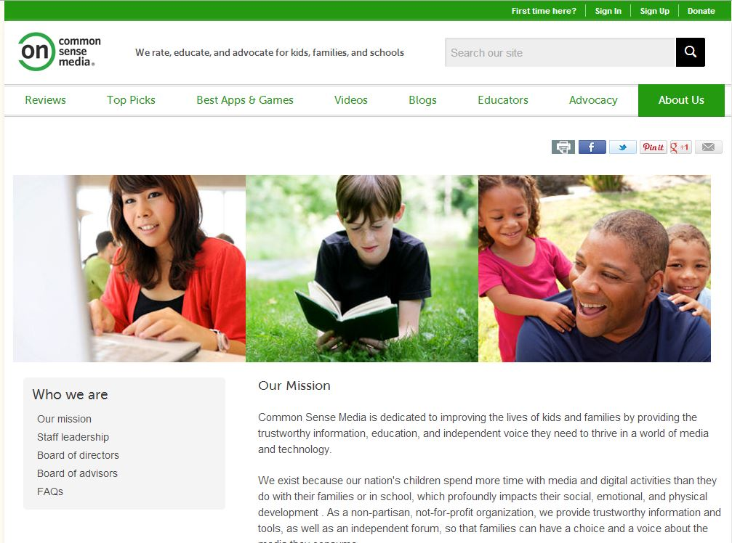
Notes:
The mission of Common Sense Media is to improve the lives of kids and families by providing trustworthy information, education, and independent voice to thrive in a world of media and technology. As they state here, they exist because our nation’s children spend more time with media and digital activities than they do with their families which profoundly impacts their social, emotional, and physical development. They are a non-partisan, not-for-profit organization that provides a plethora of important information about digital citizenship.

Slide 4
Common Sense Media – 10 Beliefs
Notes:
Common Sense Media has 10 beliefs, and the three I believe are most pertinent to us as media specialist are these:
We believe in teaching our kids to be savvy, respectful, and responsible media interpreters, creators, and communicators. We can’t cover their eyes, but we can teach them to see.
Everyone is different but all need information.
We need to teach responsible, ethical behavior online.

Slide 5
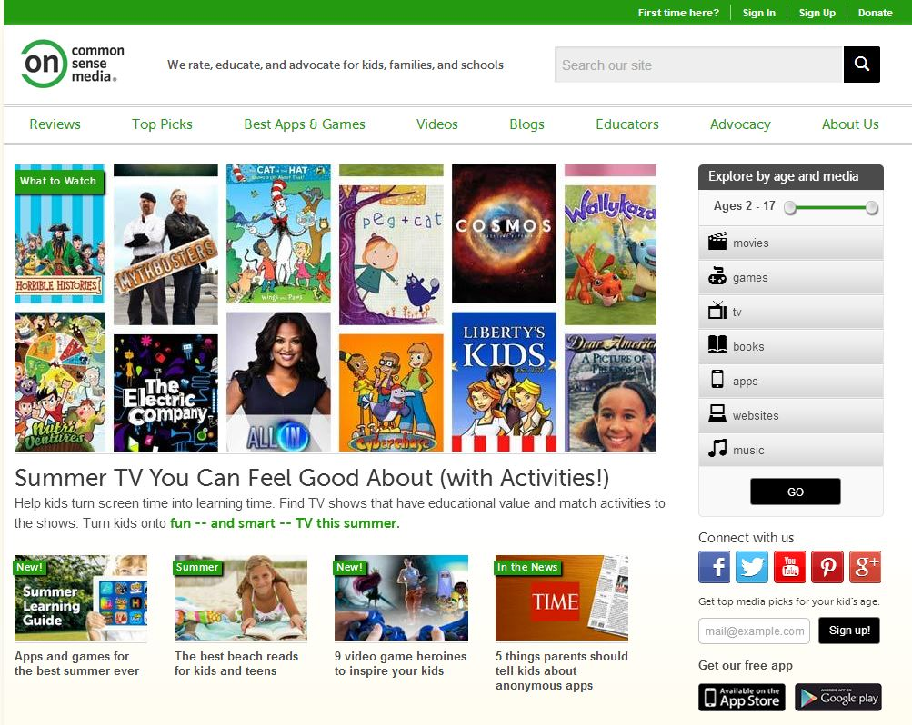
Notes:
The home page is chock full of tabs and links to top picks, best apps & games, videos, blogs, educator resources, and advocacy. I will give you a quick tour of the website and introduce the information under many of the tabs.

Slide 6
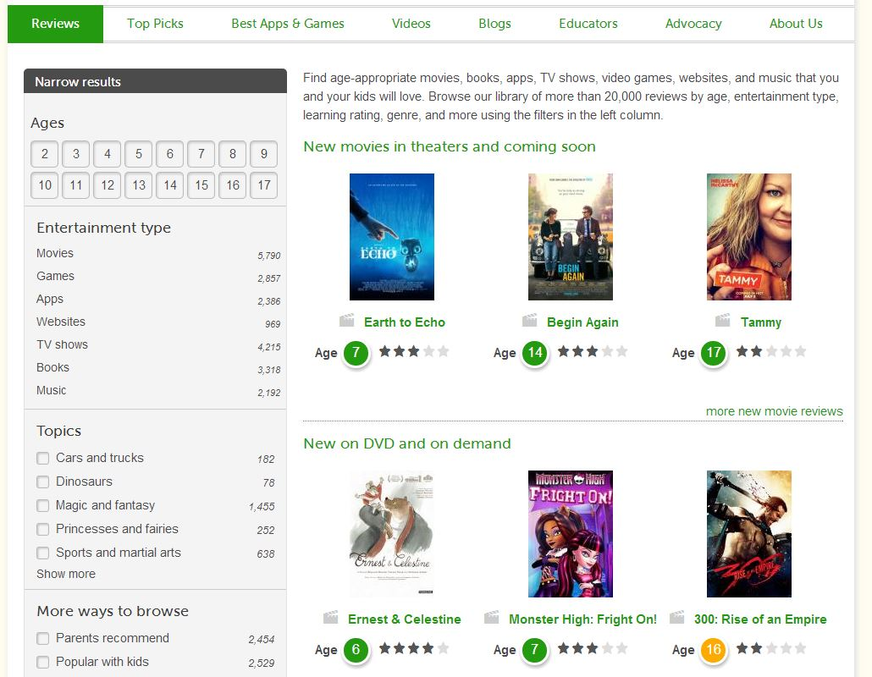
Notes:
The reviews tab helps parents and educators find appropriate movies, books, apps, TV shows, websites, video games, and music. With the roll out of Google for Education, these reviews are especially timely and important. Note that the reviews can be sorted by age, entertainment type, topic, parent recommended, and popular for kids. You may consider sharing this with your students to help them evaluate the Google Apps they will soon be using!

Slide 7
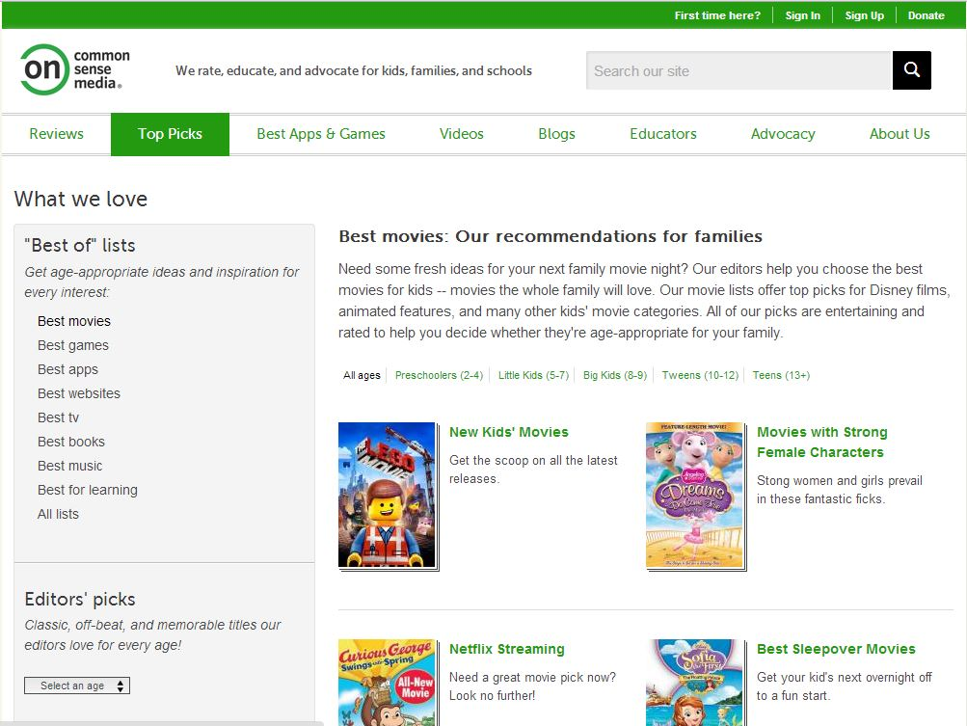
Notes:
This Top Pick tab review and recommends movies, games, apps, websites, etc. The example here is movies and they can be sorted by age, as well as by themes such as movies with strong female characters or best sleepover movies. These tabs seem to be more geared to family’s vs educators – but telling parents about this site is one great way to reach out to your school community.

Slide 8
Best-for-Learning: CSM Recommendations for Families
Notes:
CSM has a tab with recommendations for apps and websites. Reviews are by CMS staff and members of the Digital Passport for kids, which incorporates videos and games to supplement the digital citizenship curriculum. I use this online tool in one of my media center independent learning centers.

Slide 9
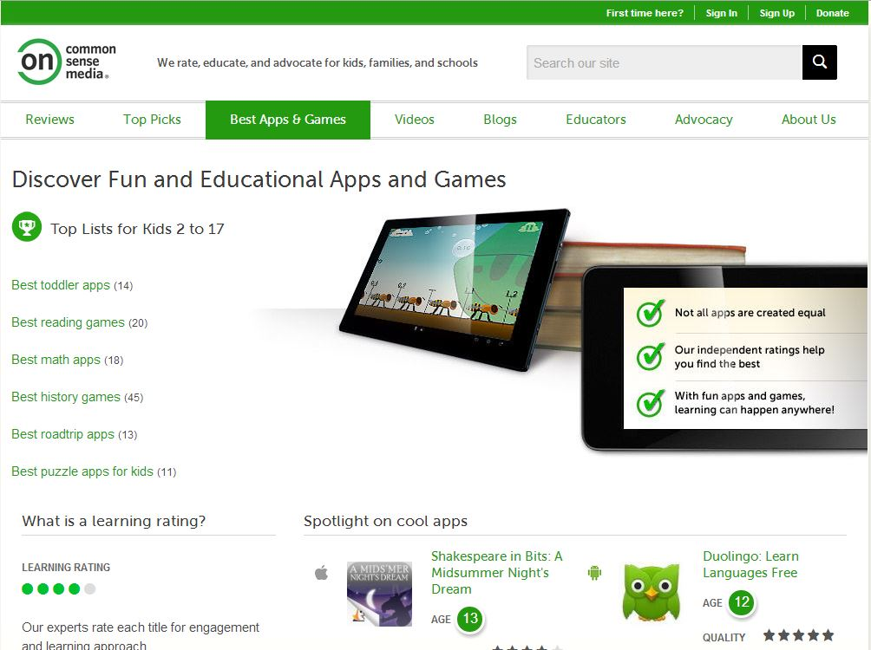
Notes:
Best Apps & Games tab reviews more educational or academic programs – these can be sorted by age, subject, or type (such as road trip apps or puzzle apps). Reviews are posted by their staff of experts.

Slide 10
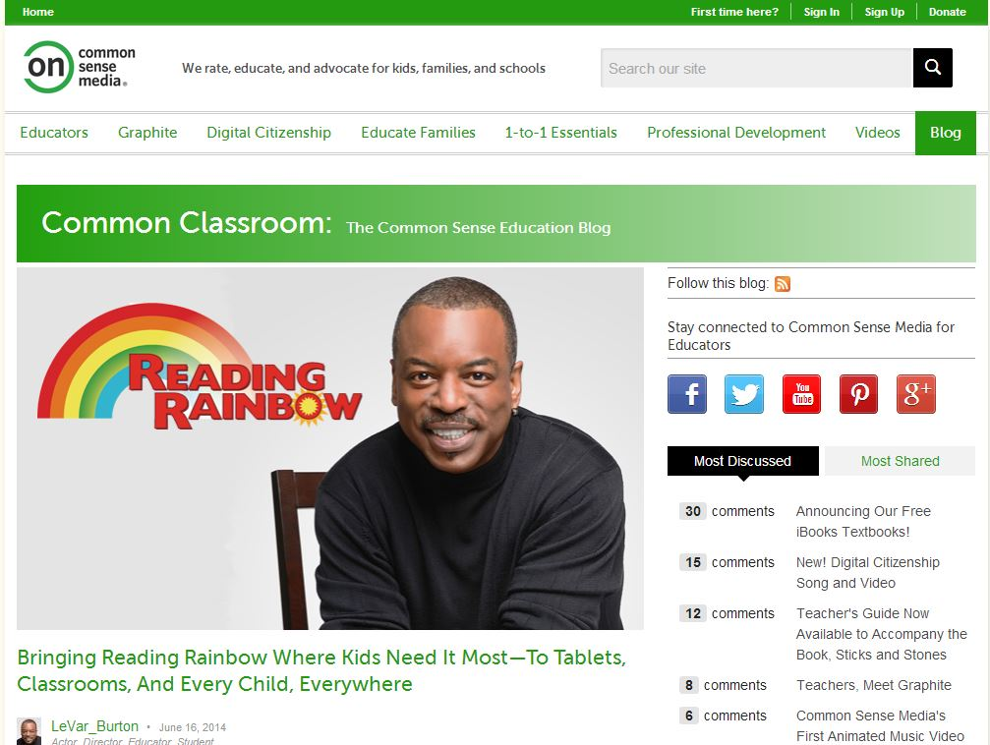
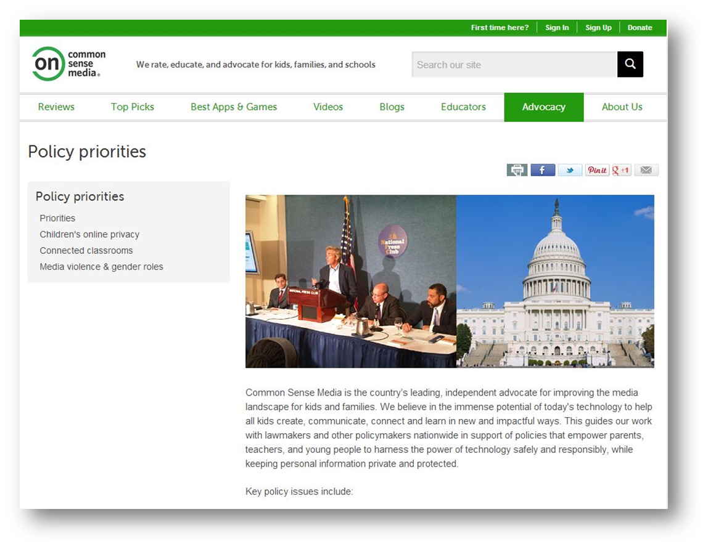
Notes:
In addition to all the other information and resources, Common Sense Media also has a blog entitled “Common Classroom” – here educators can post and share information along with the Common Sense Media staff. The organization is also an independent advocate for improving the media landscape for kids and families, and policy priorties can be found here.

Slide 11
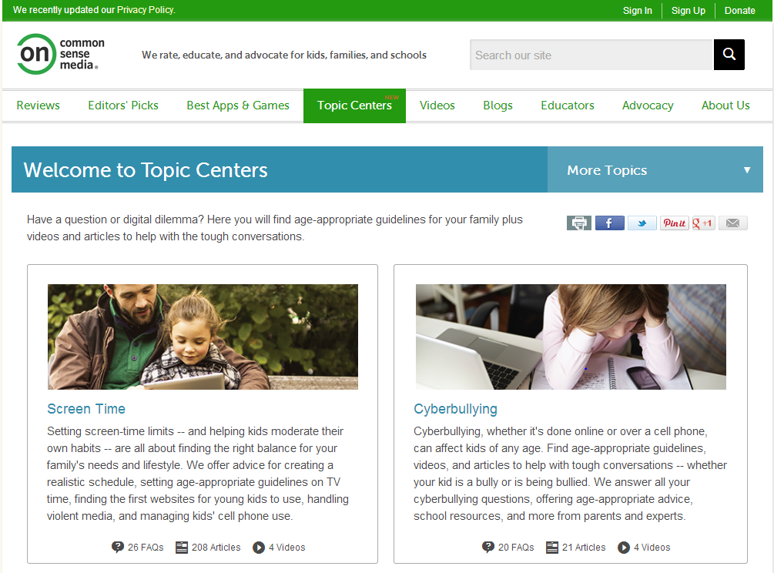
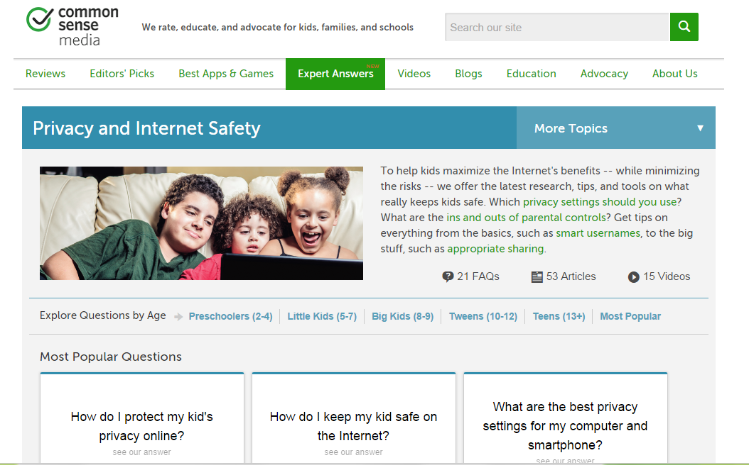
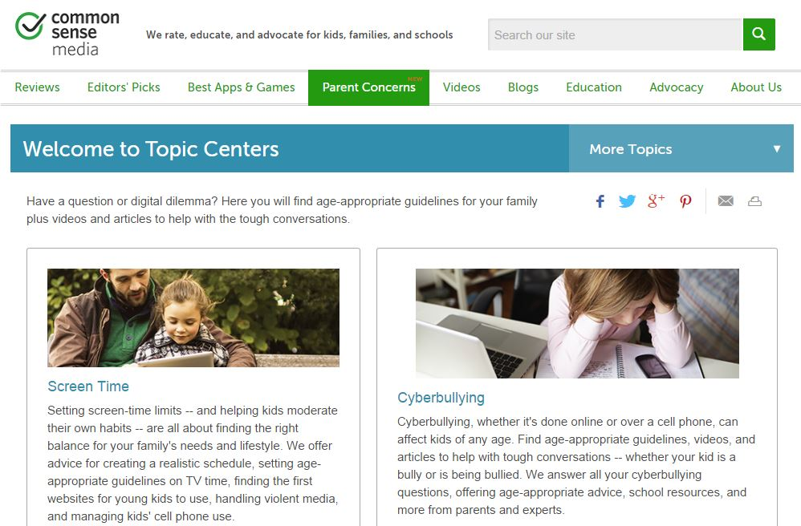
Notes:
The newest tab added to their website is this one – Parent Concerns (originally, Topic Centers changed to Expert Answers changed to Parent Concerns) - where you can find age-appropriate guidelines for your family and videos and articles to help with tough conversations. One of the many wonderful things about this site is that they are constantly updating and improving the resources – it is definitely NOT a static website!

Slide 12
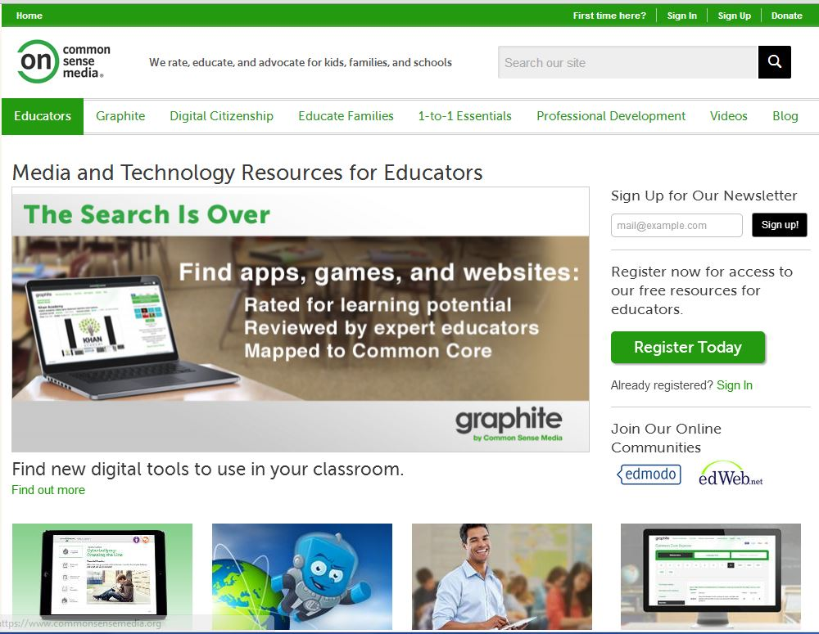
Notes:
Source-CSM website:
Here is the section with educators in mind, and you’ll see tabs that include graphite (reviews), digital citizenship curriculum, education materials for families, information to roll out to your community, professional development, videos and blog.

Slide 13
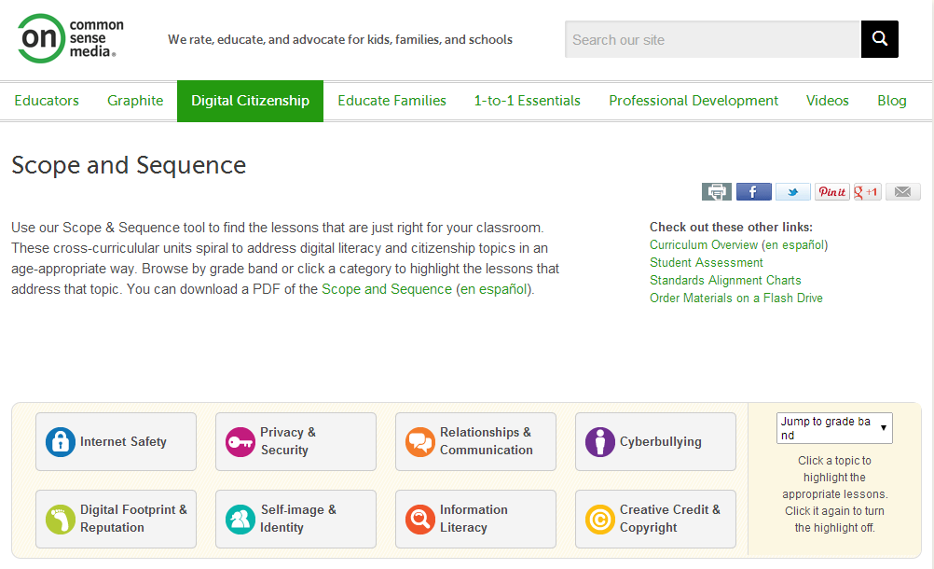
Notes:
The digital citizenship scope and sequence tool will help you find just the right lesson or unit of lessons for your classes – from kindergarten through high school. Topics range from Internet safety to digital footprint to creative credit to cyberbullying. These cross-curricular units spiral to address digital literacy and citizenship topics in an age appropriate way. The lessons often include handouts or videos, and are also available in Spanish.

Slide 14
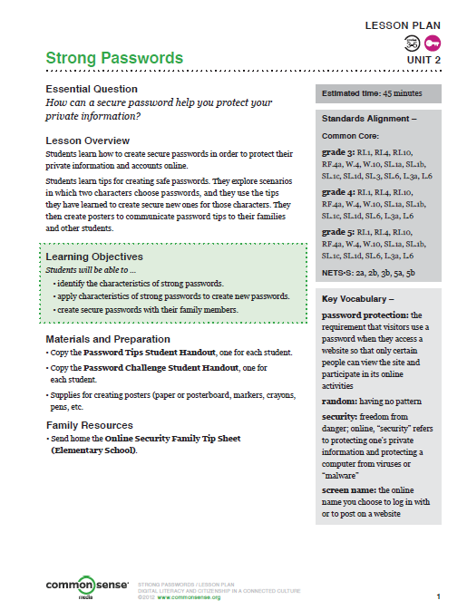
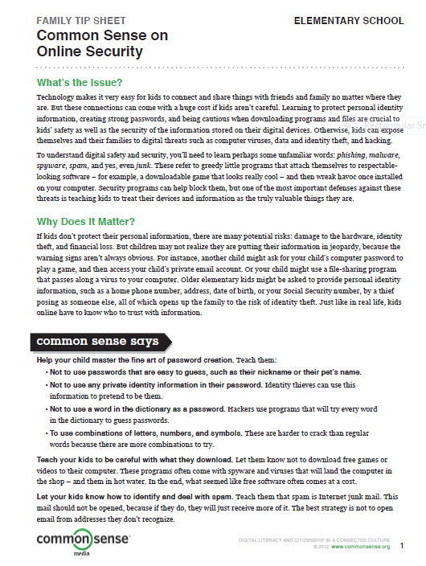
Notes:
Here are two examples of their curriculum resources – the document on the left is a lesson for grades 3-5 and the one on the right is a family tip sheet. Lessons are aligned with the Common Core State Standards and are interactive – using both high and low tech activities to help with Universal Design for Learning. If you Google CSM or the lesson plan names, you’ll undoubtedly find the lessons created on Prezi, Glogster, etc by other educators.

Slide 15
Posters & Videos
Notes:
Several printable posters, and teaching videos are available. There are also tutorials for teachers to see the lessons being taught.

Slide 16
Curriculum Training
Notes:
Source: CSM Website:
K-12 Online Curriculum Training
Ready to get started? This training will introduce you to the K-12 Digital Literacy and Citizenship Curriculum*, scope and sequence, and walk you through a few lesson plans. You'll also learn about research and background on your students' digital lives. Each training takes one hour to complete. To take the training:1. Watch the video below for your grade level.
2. At the end of the video, you'll receive a link to a survey.
3. Take the survey.
4. At the end of the survey, you'll receive a link to a certificate you can use to document professional development hours. In order to access the certificate, you will need to have registered and be logged into Common Sense Education's site. When you register, be sure to click the "I'm an Educator" box. Registration is free. You can register here.

Slide 17
Common Sense Media Educator Certification
Notes:
Source-CSM website:
Join a community of exemplary educators and schools. Apply to be Common Sense Education Certified.
At Common Sense Education, we are proud of the educators and schools who are embracing technology safely, responsibly and effectively in service of student learning.
Earn the recognition you deserve by applying to be a Common Sense Education Certified Educator or School.
Digital Citizenship Certified Educators and Schools have shown a significant commitment to teaching digital citizenship to students, staff, and families.
Graphite Certified Educators have contributed high-quality teacher Field Notes on Graphite and have committed to sharing their technology integration expertise throughout 2014.
If you are interested in applying for certification in any of these areas, click on an image to the right to get started!

Slide 18
Notes:
Source-CSM website: What are the benefits?
Being a Common Sense Education Certified Educator: Digital Citizenship is an official "stamp of recognition" from Common Sense Education. You will receive a digital badge that you can put in your email signature (or elsewhere) so others know about your efforts. We'll also send an email to your principal acknowledging the work that you're doing. This certification may open doors for you to speak to the press about these issues.
And each year, Common Sense Education Certified Educators are entered into a drawing to win the latest tech gadget, like a new iPad.
Plus, all Common Sense Education Certified Educators: Digital Citizenship receive*:
A digital citizenship poster for your classroom
A BPA-free, metal water bottle

Slide 19
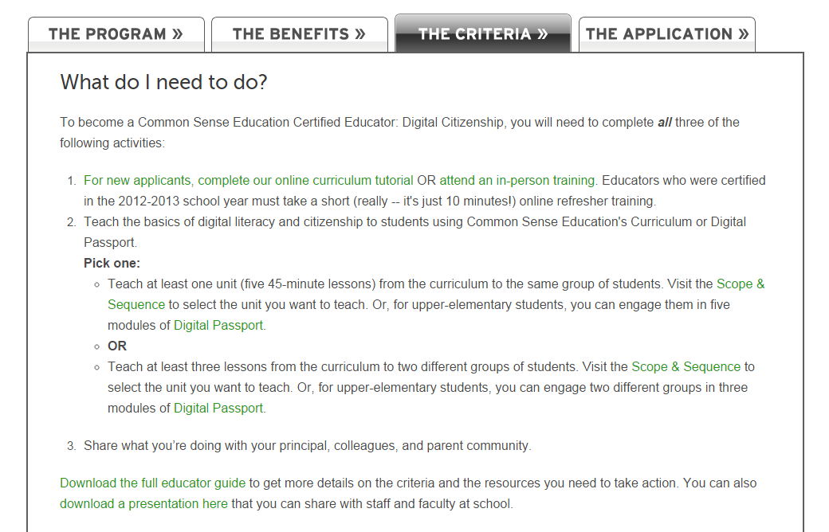
Notes:
Source-CSM website: How to apply (online application)
We know that educators are busy, so we made it pretty easy. The application shouldn’t take more than 15 minutes to complete.
You'll have to attach documentation of some of your efforts, if applicable (e.g., if you hosted a parent education workshop, you could upload your promotional flyer).
You'll have to complete the application in one sitting, because answers aren't saved if your session ends. So start the application when you have at least 15 minutes to complete it.
New applications will be accepted in September 2014.

Slide 20
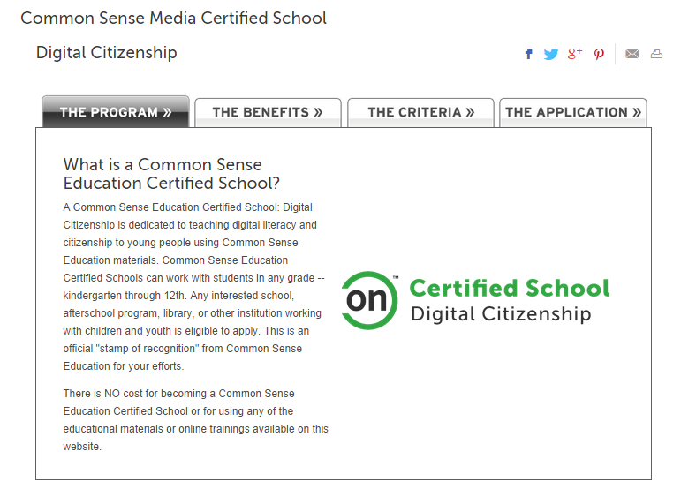
Notes:
Source-CSM website: What are the benefits?
Being a Common Sense Education Certified School: Digital Citizenship is an official "stamp of recognition" from Common Sense Education. It's our hope that acknowledging your hard work will not only strengthen the perception of your school in your community (and beyond!) but will also inspire other schools to get involved in teaching digital literacy and citizenship.
So you can let your community know that you're a Common Sense Education Certified School, we'll send you a:
Digital badge to be displayed on your website, email signatures, and elsewhere
Vinyl school banner*
Letter that you can send to your district superintendent
Press release template that you can share with your local newspaper
And if you give permission, Common Sense Education will:
List your school name on our website
Include the name of your school in a major education magazine advertisement celebrating your accomplishments
Send a letter to your state Department of Education recognizing your school as having met the Common Sense Education Certified School criteria
*Due to the high cost of shipping, we are unable to send this item to certified schools outside of the US. We apologize for any inconvenience. Please send us an email at schools@commonsense.org with any questions.

Slide 21
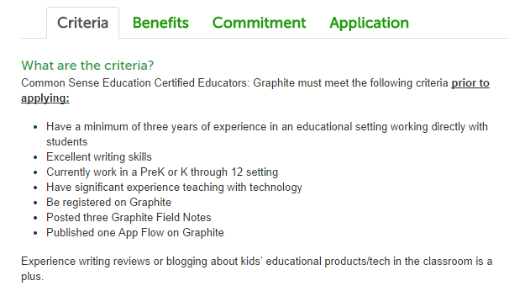
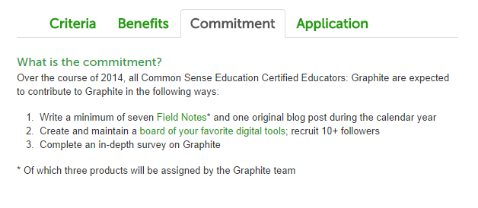
Notes:
Source-CSM website: Common Sense Education is now accepting applications from educators interested in contributing high-quality Field Notes throughout the year as members of an exceptional group we call Common Sense Education Certified Educators: Graphite. This group is composed of educators who are deeply knowledgeable about, and actively using a range of technologies with students. Ready to share valuable insights with a global audience? Apply today to be a part of this exciting program.

Slide 22
Supports for Educators
Digital Citizenship Lessons (K-12)
Graphite (find the best apps, games, and websites for the classroom)
Resources to Educate Families (handouts, blog)
1:1 Essentials (helping schools, families, and students harness the power of technology responsibly)
Professional Development
Videos (for teaching and for professional development)
Blog (one for educators, another for parents)
Notes:
There are too many resources available on the Common Sense Media website to discuss today in detail, but wanted to give you a list of the resources with educators in mind. These not only include a complete set of lesson plans for K-12, but also reviews, handouts, professional development, videos, and blogs.

Slide 23
What I Like About It:
Aligns with CCSS – Digital Citizenship is a 21st Century Skill
Integrates with our Elementary C2.0 Curriculum (MCPS)
Well designed lesson plans for K-12
Lots of resources available – for both educators and parents
Certification Process is Painless
Everything is FREE!
Notes:
There are lots of things I like about CSM. The curriculum aligns with the Common Core State Standards, and it easily integrates with the Common Core State Standard, and the lessons are age appropriate. I like that that there are lost of resources available for both educators and parents – students, too! For example, you can easily put together a presentation for parents, students, or school community with the information available. Becoming a certified educator is painless, and best of all, the information available is comprehensive and free!

Slide 24
For More Information:
Contact Common Sense Media directly @ www.commonsensemedia.org
MCPS & Cybercivility @
http://www.montgomeryschoolsmd.org/cybercivility/
Check out my Digital Citizenship LiveBinder @ http://www.livebinders.com/play/play?id=1246553&backurl=/shelf/my
Contact me via Outlook @ Melissa_A_McDonald@mcpsmd.org
Notes:
And lastly, for more information, please feel free to email me directly, or visit any of the websites listed here. This slide show is also available on the MASL conference resources page.

