Slide 1

MDK12 Online Resources
What Are They and
What Can They Do For You?
Jay Bansbach, MD State Dept. of Education
Melodi Power, Somerset Co. Public Schools
Robbie Reasoner, Montgomery Co. Public Schools

Slide 2

History
Began researching feasibility in Fall 2000
Title II D Federal EdTech Funding to establish in 2001
Year 2 – all 24 school systems and participating non-publics sign an MOU
Year 2 – All counties and participating non-publics received SIRS and World Book paid by grant – negotiations for a comprehensive purchase list for other databases begins
Notes:
The MDK12 Digital Library is a statewide purchasing consortium created to serve all 24 school districts and approximately 100 non-public schools that to date has saved the taxpayers of Maryland over $1.5 million. Housed at the MSDE since fall 2009 under guiding legislation (SB235, 2009), the project has developed by-laws, a MOU, and a committee structure similar to that in place since the project’s inception as a Federal Title IID Grant begun in 2003.

Slide 3

History
Year 3 – 50/50 split for SIRS and World Book
Year 4 – All counties purchased SIRS on their own
Grant funds used to support organization of the consortium and professional development around the use of the SIRS resources
State Legislation in 2009 to sustain the project following end of Title II D project funding – each school district signs an MOU to continue participation

Slide 4


Current Status
24 school districts participate, all must subscribe to SIRS
With SIRS subscription, all other products with negotiated prices are available to districts and schools.
100+ non-public schools continue to participate
  “25th” school district created for this group
  Billing is done through the Maryland Catholic Conference and coordinated by the Baltimore Archdiocese
Notes:
For the 2013-14 school year consortium members have access to negotiated pricing for digital content from over 25 major content providers including e-book content, and are all again subscribing statewide to a suite of ProQuest/SIRS databases. The MDK12 Digital Library leadership continues to work with public and academic libraries through the Maryland Library Consortium (MLC) to form a larger purchasing consortium. Through the MLC, MDK12 members now have access to an IP authenticated suite of EBSCO databases through the 2016 school year. Steering Committee members also participate as members of the Maryland eContent Advisory Council (MEAC) which in the fall of 2011 sponsored the first Maryland eBook Conference.

Slide 5


Consortium Pricing
Yearly negotiations to receive state pricing
Pricing from over 25 major content providers
  Over 150 different digital products
  Products for all including PreK - 12
Every school receives the same pricing model from the digital library content providers
  May be per student pricing (FTE)
  May be per school pricing

Slide 6

Maryland Library Consortium (MLC)
Effort to develop a consortium of libraries representing:
  K-12
  Public
  Universities and Colleges
Benefits:
  Further price savings on products
  Access to SAILOR databases: EBSCO Science and History Reference Centers, MasterFile Premier, and Auto Repair Reference Center
Notes:
Through the MLC currently all middle and high schools have free IP authentication databases available to them through SAILOR which includes:
EBSCO Science and History Reference Centers, MasterFile Premier, and Auto Repair Reference Center
A voluntary consortium of academic, public, school, and special libraries in the state of Maryland created to 1) leverage cooperative purchasing power for electronic resources, and 2) present a unified voice for requests made before the state
general assembly.

Slide 7
Maryland eContent Advisory Committee (MEAC)
Members of this committee will:
Learn about eContent opportunities for libraries and share current trends and developments statewide
Investigate statewide collaborative eContent projects
Provide updates and recommendations to the new Maryland Library Consortium (MLC) board for approval on statewide eContent projects
Advocate Maryland eContent needs
Notes:
The Maryland eContent Advisory Committee was developed in response to the strong interest expressed during the Maryland eBooks Summit in continuing conversations and investigating collaborative projects regarding eBooks and eContent. The first meeting was held on February 6, 2012. The group meets quarterly, as needed.
MEAC members represent the interests of academic, public, and school libraries.
This group is tasked with keeping up with the world of e‐books
and e‐content. The committee is a collaboration of public librarians, public school librarians
and academic librarians. Issues currently being discussed include the possibility of a repository
for e‐books and academic articles to serve Maryland libraries and to provide more access to e‐
content, possibly contracting with additional vendors such as EBSCO or Recorded Books.

Slide 8
5 Things to Know About
ONLINE SUBSCRIPTIONS
Students are exposed to reliable and accurate resources.
Students can access the resources from school and home.
Students can research a variety of topics and content areas.
All students can access the information at the same time.
Students will not be exposed to inappropriate websites.
Notes:
This slide highlights important information for teachers to know about online subscription services.

Slide 9
Online Opportunities for
Core Literacy Best Practices
Varied levels of text for search topic
Multimedia paired with text resources to support vocabulary, academic language, background knowledge and comprehension
Download or copy text into Word for usability adjustments (digital or paper):
  Font size
  Chunking
  Embedded questions/prompts/think alouds
  Images
  Highlight critical features or new vocabulary
Notes:
Discuss Online Options for Content Reading
Key features support the content teacher’s instructional goals.
These features make sense for all learners that are trying to stretch their decoding, vocabulary, academic language, background knowledge and comprehension.
These resources can provide scaffolds for the “just right” challenge; with text-based information for learners functioning above and below grade-level.

Slide 10
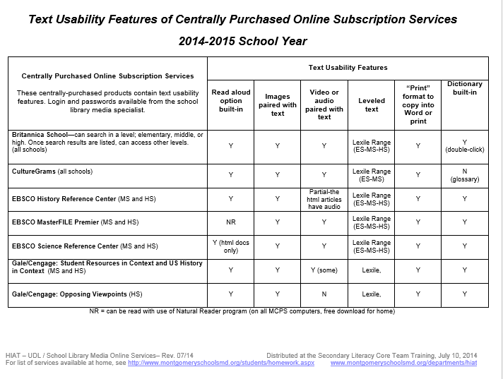
Notes:
This document is also available on the HIAT website. It is updated every year by School Library Media Programs and HIAT team members.

Slide 11
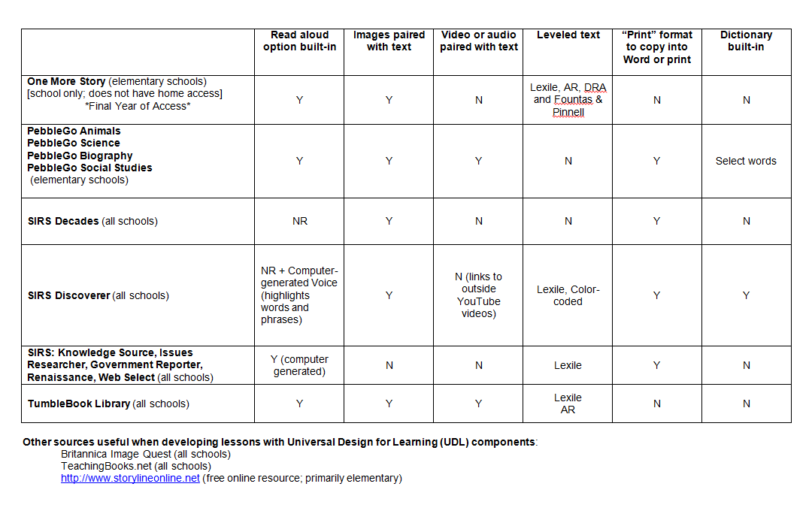

Slide 12
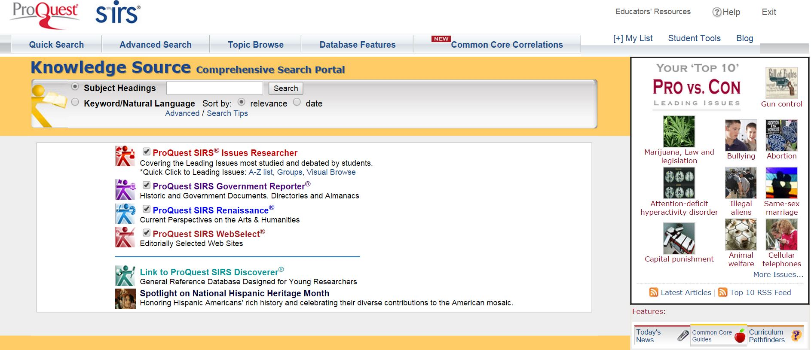
Knowledge Source
Excellent Educator Resources
Four databases in one spot
Link to SIRS Discoverer here
Notes:
Best suited for High School students, but accessible to middle schools students who are seeking higher-level results.
Targeted resources for student research
SIRS Knowledge Source (SKS) provides a portal to relevant, credible information carefully hand-selected by our SIRS editorial staff. When students use SKS, they receive best-of content designed to support student research, study, and homework in key curricula subjects. Databases cross-searchable within SKS will vary based on subscription. SIRS Knowledge Source offers National, State, Province and Common Core Standards aligned to content.
SKS can also link to other popular SIRS databases:
SIRS® Decades—Primary and secondary sources covering 20th Century American History
SIRS Discoverer®—Content hand-selected for younger researchers in grades K-9
Every SIRS article, primary source, website, and graphic has been carefully reviewed to ensure its relevancy, credibility, curricular applicability,standards alignment, and appropriateness to students.

Slide 13
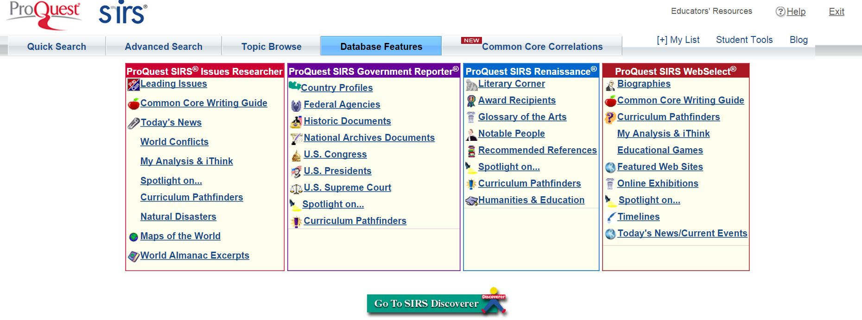
Knowledge Source
Notes:
Use SKS to search these SIRS resources at once, or to link to each SIRS collection:
SIRS® Issues Researcher—Covering the pros and cons Leading Issues most studied and debated by students
SIRS® Government Reporter—Historic and Government Documents, Directories and Almanacs
SIRS® Renaissance—Current perspectives on the arts and humanities
SIRS® WebSelect—Collection of editorially-selected reliable and credible educational websites covering all curriculum topics

Slide 14
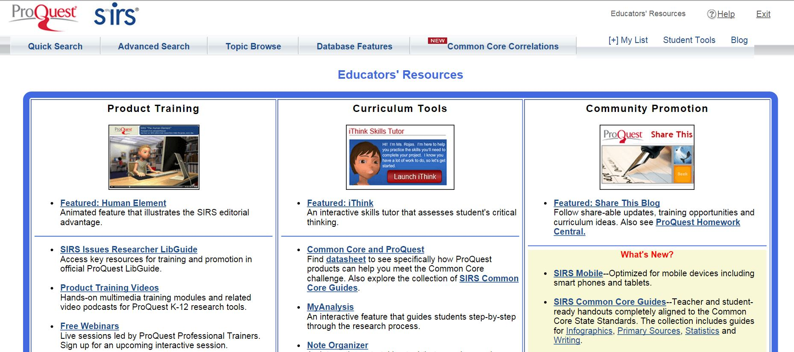
Knowledge Source
Notes:
The Educator Resources page
– Professional Development links
Student research guides and interactive skill builders
Common core alignments

Slide 15
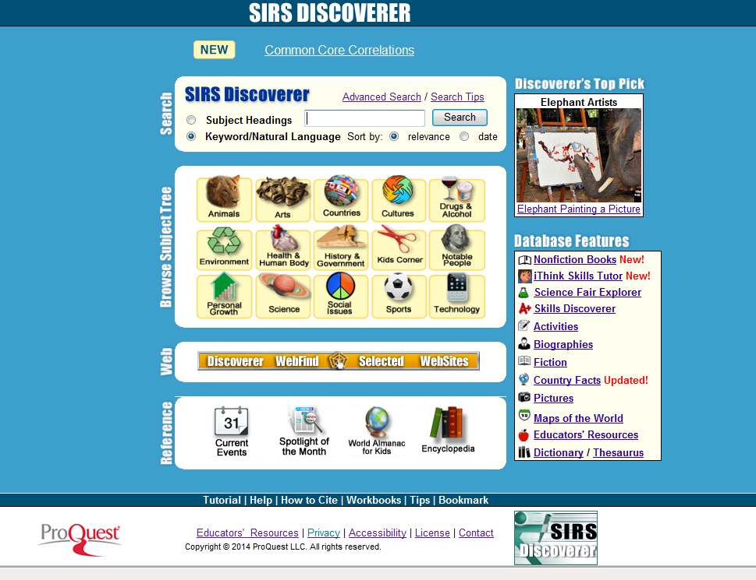
Discoverer
Search Term
Notes:
SIRS has two interfaces; one for younger students (SIRS Discoverer) and one for older students (SIRS Knowledge Source). This is an image of SIRS Discoverer from the homepage.
This database now has a read aloud feature built-in, and you can also use software apps like Natural Reader if a student gets stuck on a word or phrase.

Slide 16
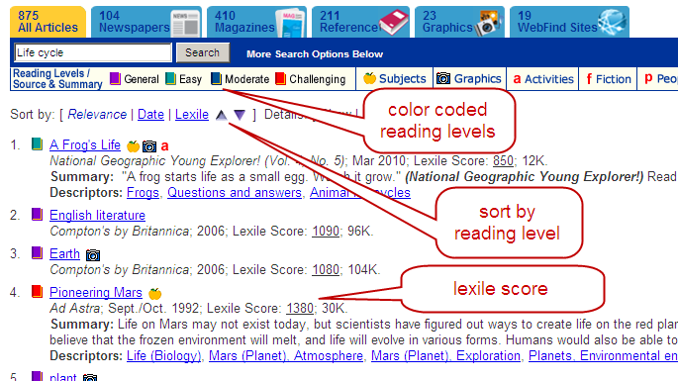
Choices for Leveled Informational text – SIRS Discoverer
Notes:
Key features of SIRS:
Color-coded Reading Levels
Sort by Reading Level
Lexile Score
Advanced Search-- Search for informational text at specific levels

Slide 17
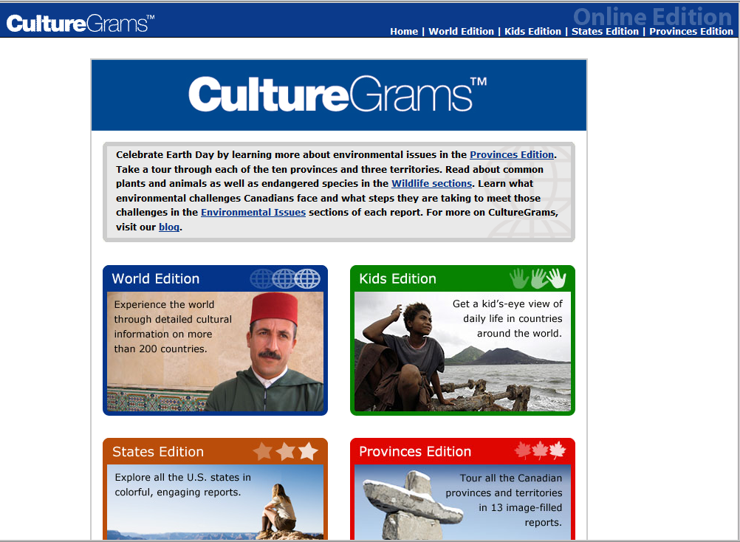
Notes:
CultureGrams provides up-to-date information on 200+ countries and cultures. 25 categories are tracked including history, land and climate, religion, personal appearance, gestures, language, government, family, dating and marriage, etc. Doesn't use Lexiles, but the "Kids Edition" is written for elementary and middle school students. It is a frequently referred to as a resource in Curriculum 2.0. What you see on this screen is at the secondary level.

Slide 18

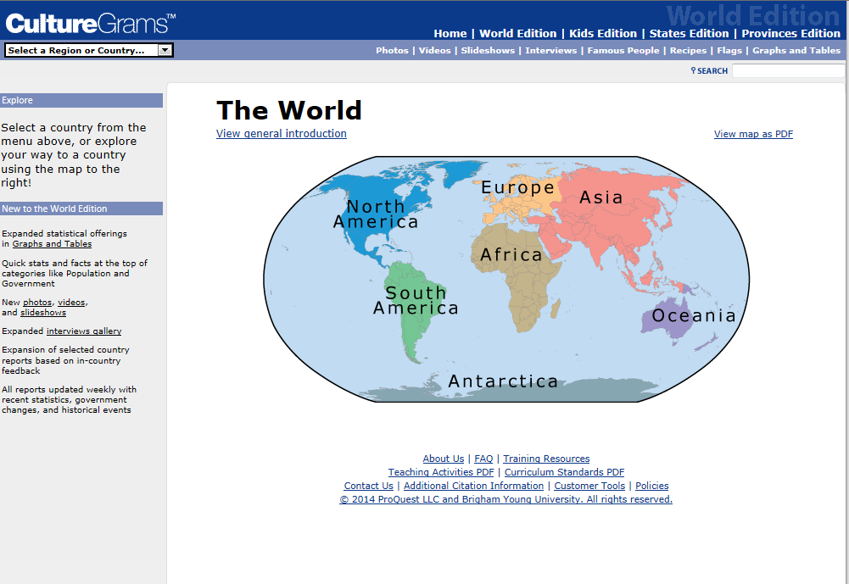
Notes:
Choose a country from the drop-down menu or enter the country name in the search box in the upper right hand corner of the screen.

Slide 19
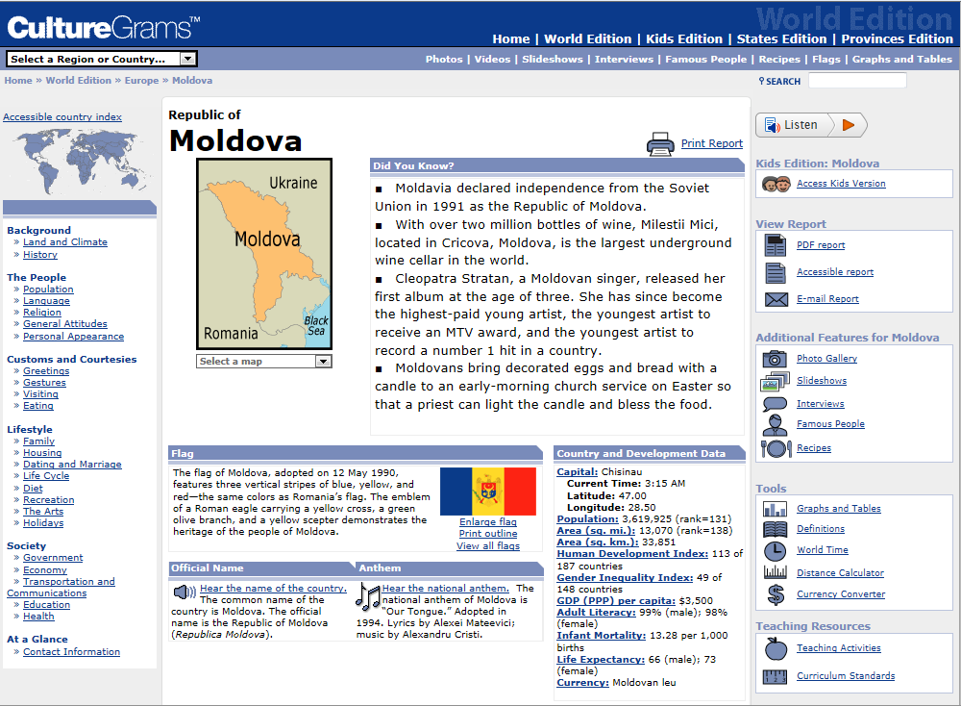
Reading Levels, Multimedia and Text Adjustments – CultureGrams™
Notes:
Features:
Read-Aloud Feature, including highlighting text as it reads, word only, sentence only, word and sentence together, text color choices, word color choices, slow, medium, fast
Varied Reading Levels – switching between World Edition and Kids Edition very easy
Provide Multimedia for background information
Text Adjustments (copy and paste into Word and manipulate text; i.e., chunking, adding images, highlight key vocabulary, increase font size, etc.)

Slide 20
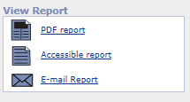
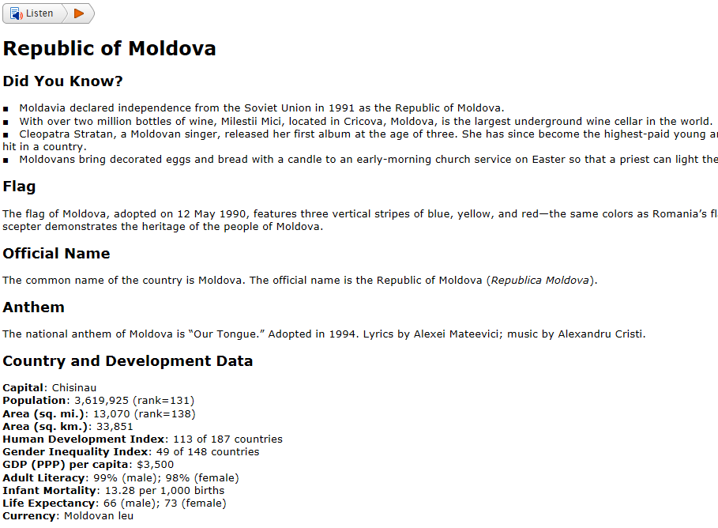

Clean Text to Copy into Word for Text Adjustments
Notes:
This is view of the “accessible report” screen that you can then copy and paste into Word.

Slide 21
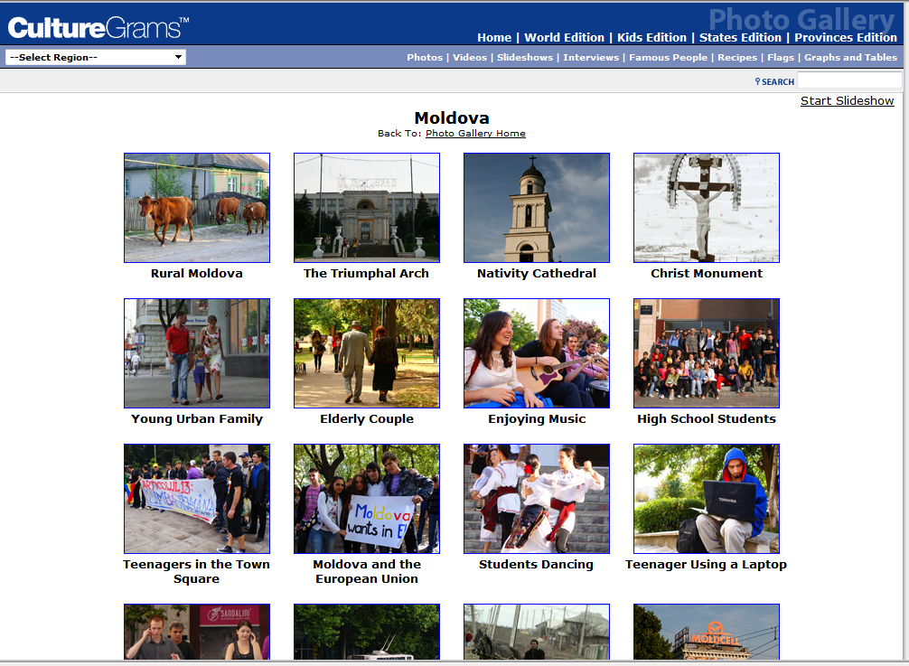
Images paired with text research to support vocabulary and comprehensions
Notes:
This is an example of the images provided in CultureGrams. These images can be used to enhance informational text in order to provide context or background information for reading passages.

Slide 22
Building Student Ownership of
Literacy Options
Recognition: make sure you explicitly state why online media subscriptions can provide options for reading (verbally, writing)
Reflection: Methods to have students document or share which choices did or did not support their learning for a specific task.
Planning: Methods for students to choose an online media subscription and tools based on choices they've had before.
Notes:
All of the products that we shared today, and any products that are purchased at the school level, all require that our students embrace and use them in their learning.
Here are three strategies to build student ownership of these literacy options:
Make your students aware of the purpose of using the subscription services
After the lesson concludes, build-in student reflection on the choices that they made
Plan your lessons with the subscription services in mind and build in their use into the assignment rubric

Slide 23
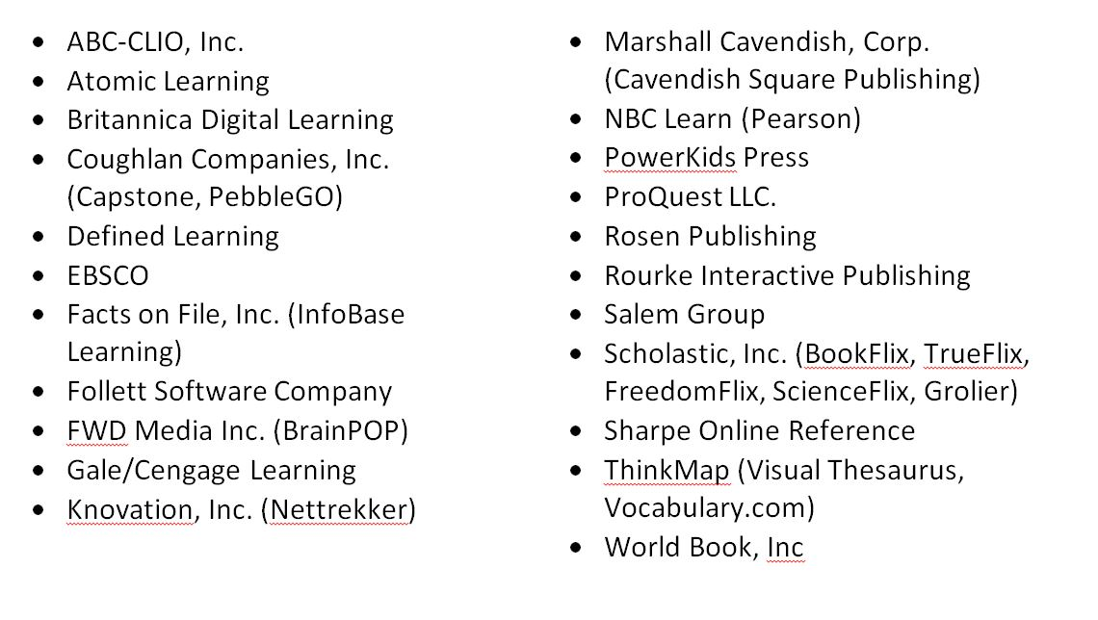
MDK12 Content Providers
2014-2015
Notes:
The DMK12 digital Steering committee coordinates the evaluation and selection of products for our content list each fall. We facilitate a Vendor day in October where providers present new and/or enhancements for their products.
We then coordinate a trials period and send out the information to all 24 schools districts and our non-public members.
The trials last two months. The information is collated by the E&S sub-committee and vendors are then contacted for pricing.
Once acceptable pricing has been submitted, the list of providers is assembled and sent to all MDK12 school systems and non-public members.

Slide 24




Next Steps
eContent
  Looking at the myriad options of eBooks and eContent from providers to obtain consortium pricing
Video Streaming
  Beginning stages to form a state committee with reps from library media and technology services from across the state to seek consortium pricing

Slide 25
Access at my school?
Ask your school’s media specialist!
Most schools have provided access points on their web page and school access is usually seamless
  passwords are needed outside of the school environment
Passwords are available from your media specialist or media supervisor

Slide 26

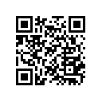
Do You Think You Are Getting the Most Out of Your Online Subscriptions?
Why or why not?
Turn and discuss
Add text to Padlet
http://padlet.com/wall/sn55ynkegira
Notes:
We would like to get gather some feedback from you; both verbally as well as virtually.
Give instructions for texting to Padlet (Formerly known as WallWisher)
And/Or, they can please turn to your neighbor and discuss this question. During your conversation, you may text a reply or two to our Padlet
Give 2 min. for participants to answer one of the questions and take 2 min. to process the answers in whole group.

Slide 27
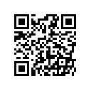
How Could These Tools Change Your Instruction?
Turn and Discuss
Add text to Padlet
http://padlet.com/wall/vix5s0xao50p
Notes:
Lastly,
Please turn to your neighbor and discuss this question. During your conversation, you may text a reply or two to our Padlet

Slide 28
Questions?
Contact us:
Jay Bansbach: carl.bansbach@maryland.gov
Melodi Power: mpower@somerset.k12.md.us
Robbie Reasoner: Roberta_C_Reasoner@mcpsmd.org
http://maslmd.org/about-mdk12/

