Slide 1
Genrefiction:
A tale of two libraries
The Why, the How, and
the Outcomes

Slide 2
About Us
Heather Hyatt
Yellow Springs Elementary
Frederick County Public Schools
heather.hyatt@fcps.org
Julia Younkins
Twin Ridge Elementary
Frederick County Public Schools
julia.younkins@fcps.org

Slide 3
Why Genrefication?
Everyday questions like: “Where are the scary books?”
Many students not selecting fiction books because of the time it took to find certain ones
Small fiction circulation after AR was gone
No assistant to help students
Most students are looking for a type of book/topic, rather than a specific author
Bookstores and many public libraries are arranged this way

Slide 4
How Heather tackled it
Selected what genres I wanted in the library
Historical Fiction (HIS)
Mystery (MYS)
Adventure (ADV)
Science Fiction (SCI)
Fantasy (FAN)
Realistic Fiction (REAL)
Sports Fiction (SPO)
Classic Fiction(CLA)
Funny Fiction (FUNNY)
Weeded books

Slide 5
...continued
Separated books into genres
I cleared out a bookcase and started to tackle one genre at a time.
I selected books by obvious, using Amazon/Titlewave, thought about what kind of genre reader would read the book.
Tagged book spines (Thanks to parent volunteers)
Changed books in OPAC
I added the genre into the prefix on the computer
Labeled shelves and added genre definitions
Lesson to show students

Slide 6
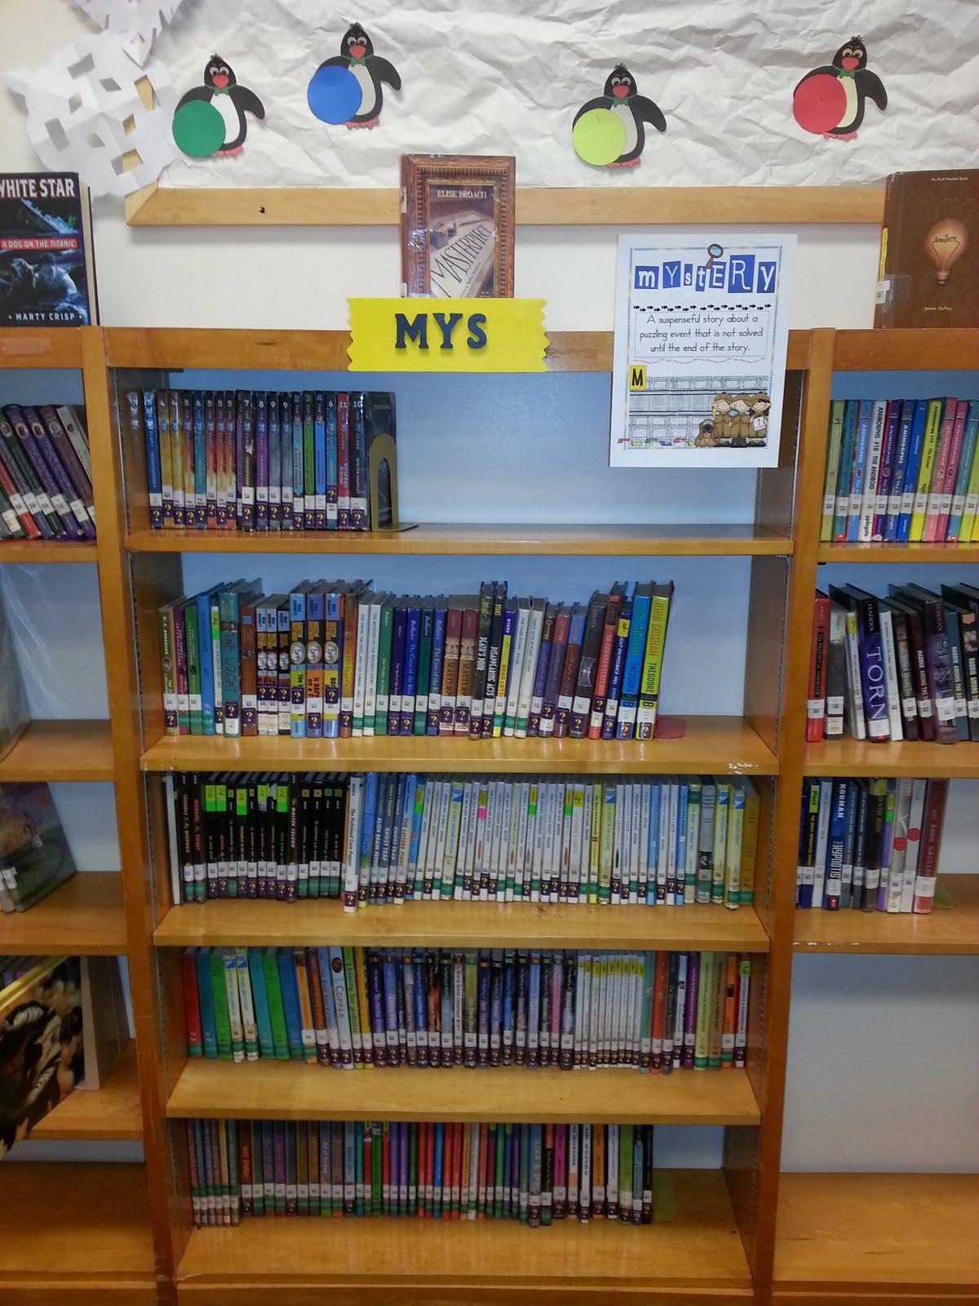
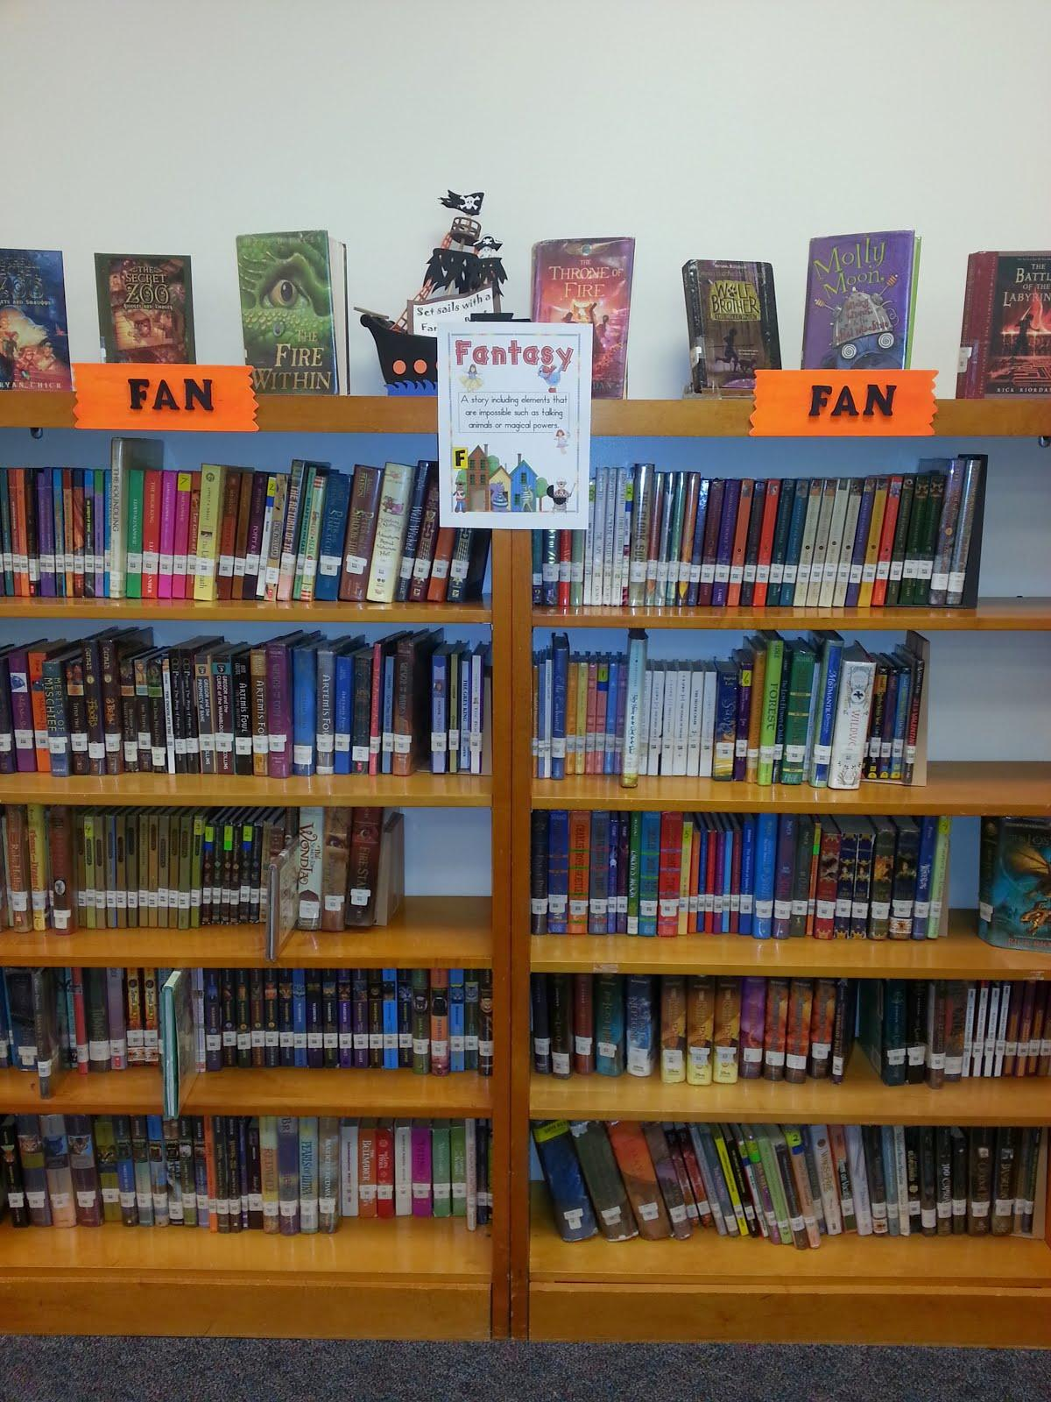
Bookcases

Slide 7
How Julia tackled it
Significant weeding
Talked to Heather!
Determined genres:
Humor
Fantasy
Mystery
Adventure
Historical Fiction
Scary
Science Fiction
Realistic Fiction

Slide 8
...continued
Determined genre for each book and stickered (mostly delegated to a trusted volunteer)
Only chose one genre, even if book fit multiple
Physically sorted books- everything off the shelves, books on carts/tables by genre
Determined space needed for each genre
Changed call letters in TLC- added a prefix for the genre
Physically put books on shelves
Added signage, informed students & staff

Slide 9
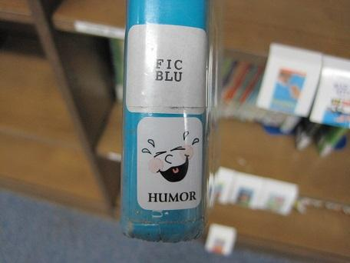
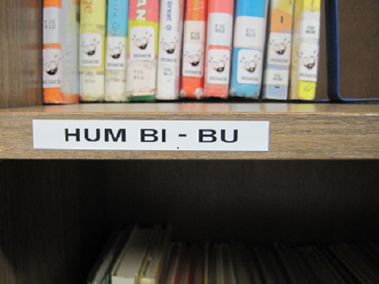
Example: Humor labels

Slide 10
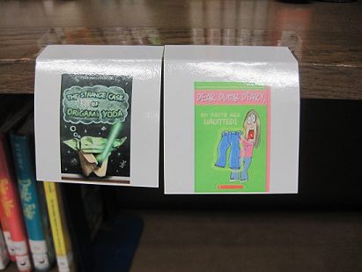
Series images
Assist students in locating their favorites
Assists volunteers in shelving

Slide 11
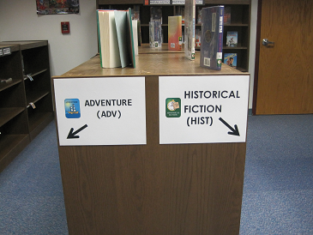
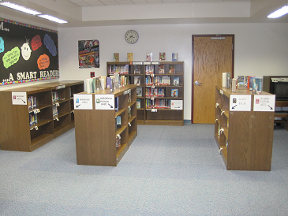
Signage

Slide 12
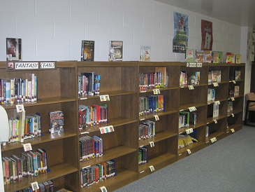
Signage

Slide 13
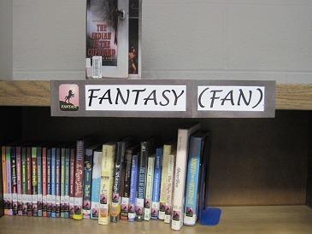
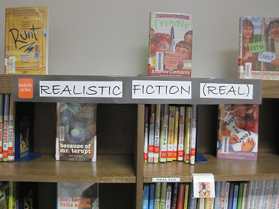
Signage

Slide 14
The Results
Students love it
Increased fiction circulation
Twin Ridge: anecdotal
Yellow Springs data:
(Before genrefication) 2009/2010: circulated 5,094
(First year) 2010/2011: circulated 5,937
Last year: circulated 6,360
Better browsing
Students are more independent in selecting books
Easier to find something similar after they read a book that they like

Slide 15
Challenges
Time consuming
Space
Choosing the right genre for each book
Authors that write multiple genres
Newly ordered titles

Slide 16
Dewey is still with us
Our nonfiction sections are still organized by Dewey Decimal; we still teach our students that system of organization.
Good teaching in the library means that students gain the skills to find information. We are still teaching them to use the OPAC, write down a call number, and use signage to find the book. This process is the same with Dewey, Library of Congress, and Genrefication.
At one time, fiction was in the Dewey 800’s. It was separated out because it made sense. In today’s world, for our students, genrefication makes sense!

Slide 17
Blogs and Articles on the Subject
Ditching Dewey: Hot Topic in Hartford | AASL 2013 http://www.slj.com/2013/11/collection-development/ditching-dewey-hot-topic-in-hartford-aasl-2013/#_
Mr. ReaderPants: http://www.readerpants.net/2011/09/genre-fication-project.html
Mighty Little Librarian: http://www.mightylittlelibrarian.com/?p=582
YA Books and More: http://naomibates.blogspot.com/2013/10/why-genrefy-hows-and-whys-i-decided-to.html

Slide 18
Questions???

